Slide 1
Digital Portfolio
STUDENT NAME: v.arasu
REGISTER NO AND NMID:
222404550/CF868D1EE09587CA7CD4D67353EFB52F
DEPARTMENT: bsc.software application
COLLEGE: COLLEGE/ UNIVERSITY: A.M.jain college

Slide 2
PROJECT TITLE
v
DIGITAL PORTFOLIO

Slide 3


AGENDA
Problem Statement
Project Overview
End Users
Tools and Technologies
Portfolio design and Layout
Features and Functionality
Results and Screenshots
Conclusion
Github Link
3/21/2024 Annual Review

Slide 4

PROBLEM STATEMENT 1)Building The structure 2)Giving Perfect Colors 3 ) Inserting pictures 4) Making Scrolling smooth 5) Making it Responsive

Slide 5

PROJECT OVERVIEW A Digital Portfolio fully attac hed about my skills in the software world and also it holds my project i have linked my github , linkedin ,Twitter profile

Slide 6

WHO ARE THE END USERS? The Companies I go for Interview My Online Clients

Slide 7

TOOLS AND TECHNIQUES HTML css JAVASCRI PT

Slide 8
POTFOLIO DESIGN AND LAYOUT
It has a maginificent Purple blended violet colors and it has my profile photo , My name in the Starting
after scrolling down you can find my projects , and what Skills do i have and lastly you got a information box
to fill up your details and get in touch with me...
- Thank you!!
8

Slide 9
FEATURES AND FUNCTIONALITY Displays My Essential Details Scrolls Smootly it has a Arrow button in the left to scroll up from down

Slide 10
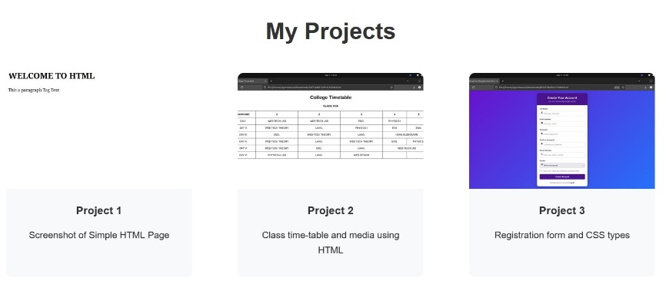
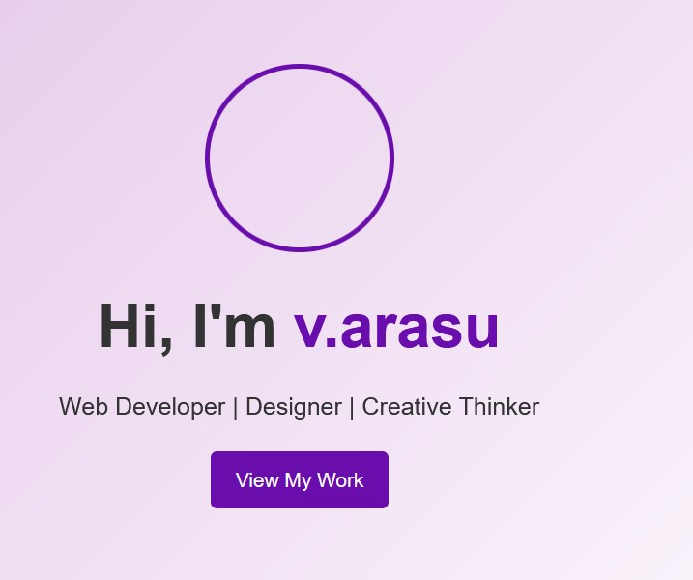
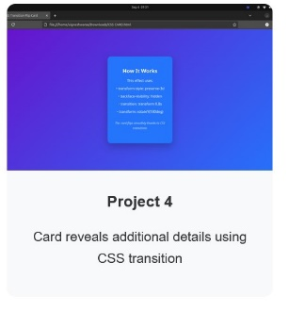

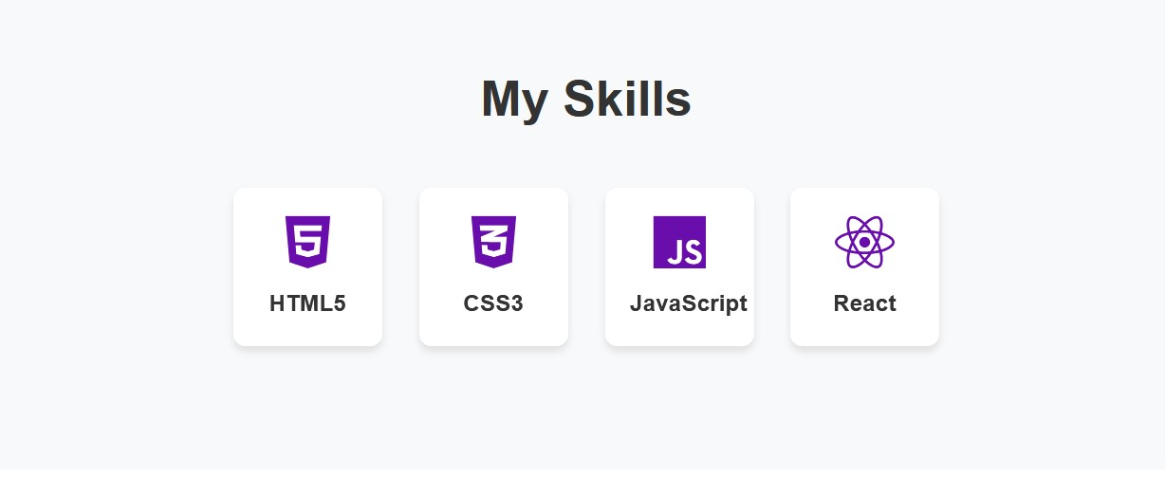
RESULTS AND SCREENSHOTS
3/21/2024 Annual Review
10

Slide 11
CONCLUSION I have created this Portfolio with myHardwork and consistency
Server link: https://github.com/24j006-arasu/TNSDC-FWD-DigitalPortfolio.git
Deployment link: https://24j006-arasu.github.io/TNSDC-FWD-DigitalPortfolio/
11

